Slide 1


PYTHON
Lecture 51

Slide 2

Today’s Agenda
Database Programming In Python-III
Executing INSERT Command
Executing Dynamic Queries
Concept Of Bind Variables
Executing Update Command
Executing Delete Command

Slide 3
Inserting Record
To insert a new record in the table we have to execute the INSERT INTO command.
It has 2 syntaxes:
Insert into <table_name> values(<list of values>)
Insert into <table_name>(<list of cols>) values(<list of values>)

Slide 4
Inserting Record
To insert a record in the table from our Python code we simply pass the insert query as argument to the execute( ) method of cursor object.
It’s general syntax is:
cur.execute(“insert query”)
Two important points:
After executing insert if we want to get the number of row inserted we can use the cursor attribute rowcount
Unless we call the method commit( ) of connection object , the record we insert does not get saved in the table

Slide 5
Steps Required For Inserting Records
For inserting record the overall steps are:
Import the module sqlite3
Establish a connection to the database.
Create a cursor to communicate with the data.
Execute the Insert query
Commit the changes
Close the connection to the database.

Slide 6

Example
import sqlite3
conn=None
try:
conn=sqlite3.connect("d:/mysqlitedb/library.db")
print("Connected successfully to the DB")
cur=conn.cursor()
cur.execute("Insert into allbooks values(108,'Python Web Prog',500,'Python')")
n=cur.rowcount
print(n," row inserted")
conn.commit()
except (sqlite3.DatabaseError)as ex:
print("Error in connecting to Sqlite:",ex)
finally:
if conn is not None:
conn.close()
print("Disconnected successfully from the DB")

Slide 7
Executing Dynamic Queries
Dynamic queries are those where we set the values to be passed in the query at run time.
For example , we would like to accept the values of the record to be inserted from the user and then pass it to the insert query.
Such queries are called dynamic query

Slide 8
Executing Dynamic Queries
Dynamic queries for Sqlite can be set using the concept of bind variables
Bind variables are like placeholders used in a query , represented using :some_number, and are replaced with actual values before query execution.

Slide 9
Using bind variables By Position
In this Insert query :1,:2,:3 and :4 are called bind variables and they will be replaced with the values of the actual variables id,name,price and subject before the query is sent for execution. Also , parenthesis is required because these values are sent as a tuple
import sqlite3
conn=None
try:
conn=sqlite3.connect("d:/mysqlitedb/library.db")
print("Connected successfully to the DB")
cur=conn.cursor()
id=int(input("Enter bookid:"))
name=input("Enter bookname:")
price=int(input("Enter bookprice:"))
subject=input("Enter subject:")
cur.execute("Insert into allbooks values(:1,:2,:3,:4)",(id,name,price,subject))
n=cur.rowcount
print(n," row inserted")
conn.commit()
except (sqlite3.DatabaseError)as ex:
print("Error in connecting to Sqlite:",ex)
finally:
if conn is not None:
conn.close()
print("Disconnected successfully from the DB")

Slide 10
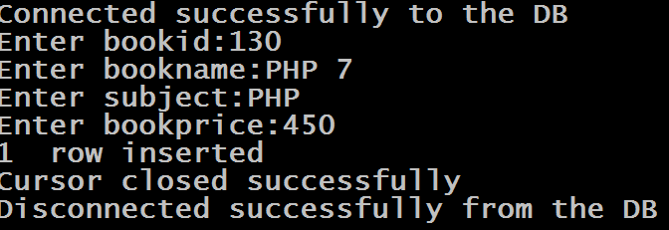
Sample Output

Slide 11
Updating Record
To update a record in the table we have to execute the UPDATE command.
It has 2 syntaxes:
Update <table name> set <col name>=<value>
Update <table name> set <col name>=<value> where <test condition>

Slide 12
Updating Record
Updating a record through Python code is same as inserting a new record. .
We call the method execute( ) of cursor object passing it the update query.
It’s general syntax is:
cur.execute(“update query”)
If the query is dynamic then we can use bind variables for setting the values at run time.

Slide 13
Example
import sqlite3
conn=None
try:
conn=sqlite3.connect("d:/mysqlitedb/library.db")
print("Connected successfully to the DB")
cur=conn.cursor()
cur.execute("Update allbooks set bookprice=500 where bookid=201 ")
n=cur.rowcount
print(n," row updated")
conn.commit()
except (sqlite3.DatabaseError)as ex:
print("Error in connecting to Sqlite:",ex)
finally:
if conn is not None:
conn.close()
print("Disconnected successfully from the DB")

Slide 14
Exercise
Write a program to accept a subject name and an amount from the user and increase the price of all the books of the given subject by adding the amount in the current price. Finally display whether books were updated or not and how many books were updated

Slide 15
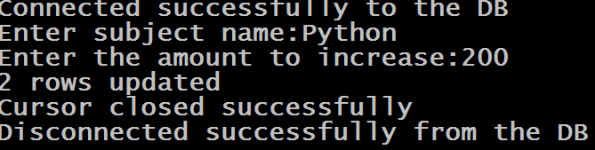
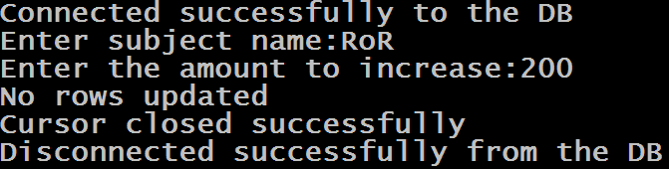
Sample Output
Sample Run 1
Sample Run 2

Slide 16
Solution
import sqlite3
conn=None
try:
conn=sqlite3.connect("d:/mysqlitedb/library.db")
print("Connected successfully to the DB")
subject=input("Enter subject name:")
amount=int(input("Enter the amount to increase:"))
cur=conn.cursor()
cur.execute("Update allbooks set bookprice=bookprice+:1 where subject=:2",(amount,subject))
n=cur.rowcount
if n==0:
print("No rows updated")
else:
print(n, "rows updated")
conn.commit()
except (sqlite3.DatabaseError)as ex:
print("Error in connecting to Sqlite:",ex)
finally:
if conn is not None:
conn.close()
print("Disconnected successfully from the DB")

Slide 17
Deleting Record
To delete a record from the table we have to execute the DELETE command.
It has 2 syntaxes:
Delete from <table name>
Delete from <table name> where <test condition>

Slide 18
Deleting Record
Deleting a record through Python code is same as updating/inserting a record. .
We call the method execute( ) of cursor object passing it the delete query.
It’s general syntax is:
cur.execute(“delete query”)
If the query is dynamic then we can use bind variables for setting the values at run time.

Slide 19
Example
import sqlite3
conn=None
try:
conn=sqlite3.connect("d:/mysqlitedb/library.db")
print("Connected successfully to the DB")
cur=conn.cursor()
cur.execute("Delete from allbooks where bookid=109")
n=cur.rowcount
print(n," row deleted")
conn.commit()
except (sqlite3.DatabaseError)as ex:
print("Error in connecting to Sqlite:",ex)
finally:
if conn is not None:
conn.close()
print("Disconnected successfully from the DB")

Slide 20
Exercise
Write a program to accept a subject name from the user and delete all the books of the given subject .Finally display whether books were deleted or not and how many books were deleted

Slide 21
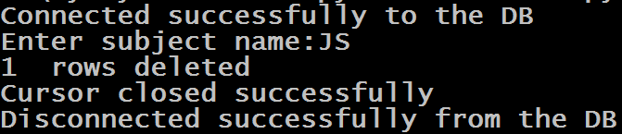
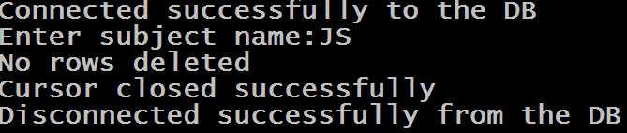
Sample Output
Sample Run 1
Sample Run 2

Slide 22
Solution
import sqlite3
conn=None
try:
conn=sqlite3.connect("d:/mysqlitedb/library.db")
print("Connected successfully to the DB")
cur=conn.cursor()
subject=input("Enter subject name:")
cur.execute("Delete from allbooks where subject=:1",(subject,))
n=cur.rowcount
if n==0:
print("No rows deleted")
else:
print(n," rows deleted")
conn.commit()
except (sqlite3.DatabaseError)as ex:
print("Error in connecting to Sqlite:",ex)
finally:
if conn is not None:
conn.close()
print("Disconnected successfully from the DB")

